Slide 1
Role of Supply Chains
Unit 1: Defining the Freight System

Slide 2
What is a Supply Chain
All stages involved, directly or indirectly, in fulfilling a customer request
Includes manufacturers, suppliers, transporters, warehouses, retailers, and customers

Slide 3
Why do we care about supply chains?
Supply chains represent the decision making entities in goods movement
Their collective decision making creates the activity of the freight transportation system
To understand how things might change with changing conditions, we need to understand their logic

Slide 4
What is the parallel in passenger transportation?
What is the decision making unit?
What do we do to try to understand their logic?
What tools do we use to estimate their behavior?

Slide 5
How does REI get goods to market?
Asian
Factories
West Coast
Port
Distribution
Center
Destination
Store
Container on
marine vessel
Drayage
truck
Short or
Long-haul
truck

Slide 6
How do we observe the effects of changing supply chains? Warehouse sizes

Slide 7
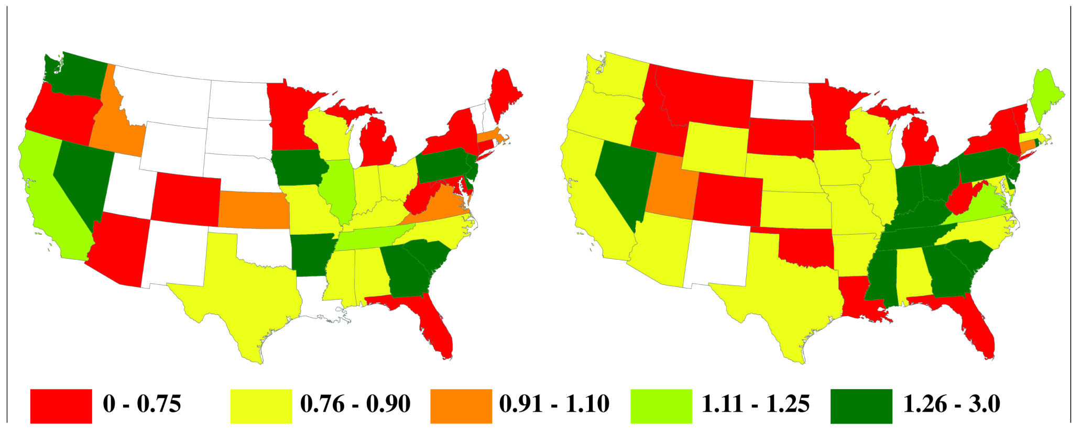
Warehousing Location Quotients by State
1998 and 2006 (Source: U.S. Census County Business Patterns)

Slide 8
Other trends
Larger container vessels
Expansion of Panama Canal
4 corners import strategy
Use of multiple distribution centers
Mode shifting

Slide 9
Challenges
Obtaining information
How do we know what moves around, when it moves, and where it goes?

Slide 10
Freight Traffic Data
Truck
Fixed location counts (WIM stations)
Rail
Waybill sample restricted access
Air
Flight data available from FAA
Very limited commodity data
Water
Army Corps substantial volume data
General lack of knowledge about what is IN the vehicles

Slide 11
Commodity Flow Data
Commodity Flow Survey (BTS)
Freight Analysis Framework
Import and Export control at ports and borders
Value
Weight
Vehicle counts must be estimated
Typically misses intermediate locations

Slide 12
Potential solutions
Case Studies
Very difficult to build up the system from individual firms or commodities
Required data submission
Mile taxes in Ontario and Oregon
Refining commodity flow data at a regional level

Slide 13
Example of Investigating Current Supply Chain Issues Estimating Freight Flows in WA State: Case studies in data-poor and data-rich environments
Work by: Anne Goodchild, Derik Andreoli,
Eric Jessup, and Sunny Rose
Notes:
13

Slide 14
Research Problem
Freight supports regional economies
Desire to justify investments targeting freight
Evaluate the impacts of network changes
Vulnerability to disruptions
Improvements and infrastructure needs
quantify the value of improvements
Limited by available data

Slide 15
State of Freight Modeling
Currently two primary modeling sources:
Commodity flow data
Gross vehicle volumes
Assume industries use infrastructure in the same way
Existing methods are too coarse for needed analysis
Commodity flow data spatially aggregate
Vehicle estimates are categorically aggregate
Basic problem in freight modeling
Lack of quality disaggregate commodity flow data

Slide 16
Project Scope
Improve the representation of freight movement in statewide modeling
Work within existing data constraints
Develop and implement a methodology to estimate industry-specific, corridor-level truck trips
Study Washington State due to the frequent disruptions to key freight corridors
I-5 (flooding)
I-90 (avalanche)
Snoqualmie Pass closed ~370 hours in 2007-2008 winter season
Snow Affects I-90 (and 2 & 12); Highway 410 and Highway 20 are closed seasonally every winter
Longest closures are 3-5 days long
No way to turn around

Slide 17
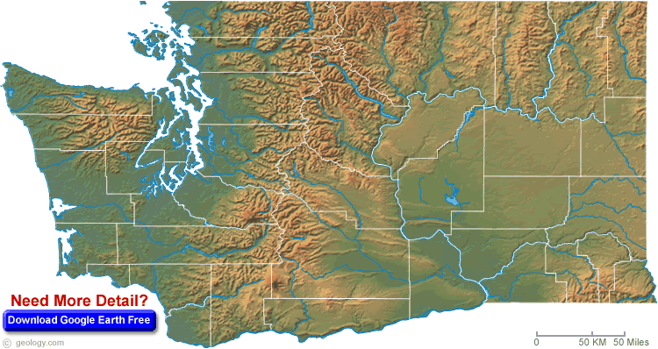
Washington State Topography
SEATTLE
SPOKANE
CASCADES RANGE
YAKIMA
VANCOUVER
Map courtesy of geology.com

Slide 18
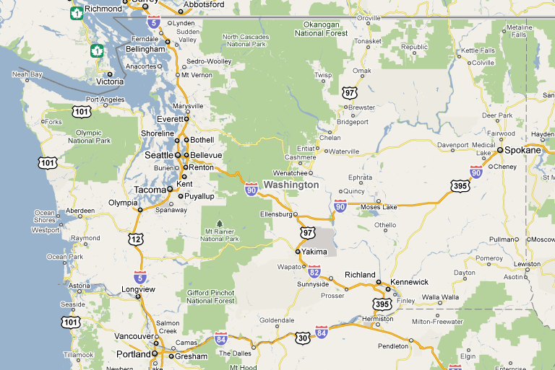
Washington State Infrastructure
Only 3 ways across the Cascades
SEATTLE
SPOKANE
YAKIMA
VANCOUVER
Cascade passes significantly limit east-west travel
In the winter, only 3 routes cross the cascades: I-90, Highway 2, and State Route 12
ALL are very prone to avalanche danger and have frequent closings of varying lengths
Which helps more: information on closures or solutions to improve reliability

Slide 19
Focus on Two Sample Data Sources
Estimate statewide truck trips required for the operation of industries within Washington State
Data-rich industry: potato distribution
Idealized case
Information about production, processing, demand, distribution, capacity ratios
Data-poor industry: diesel distribution
Realistic case
Use estimated origins & destinations
How to model flows?
Photo courtesy of WSDOT

Slide 20
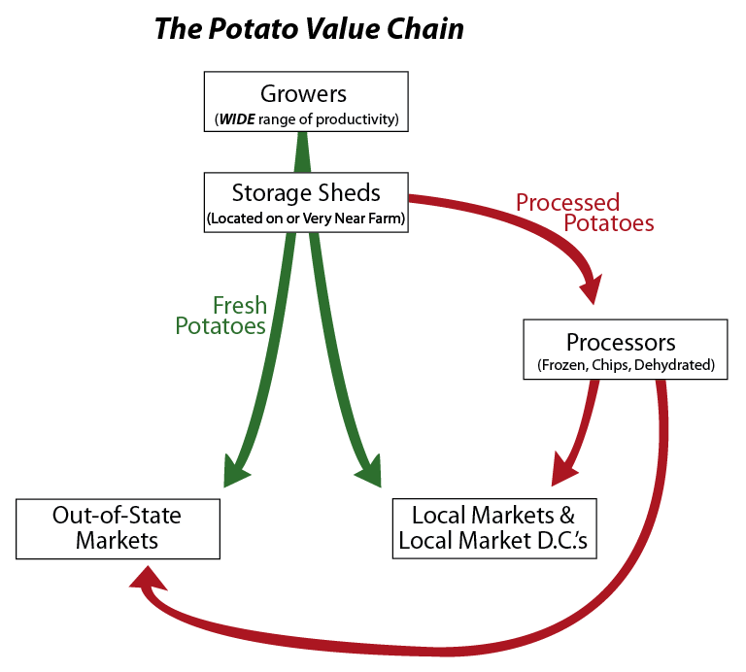
Details to be discussed in a later lecture…

Slide 21
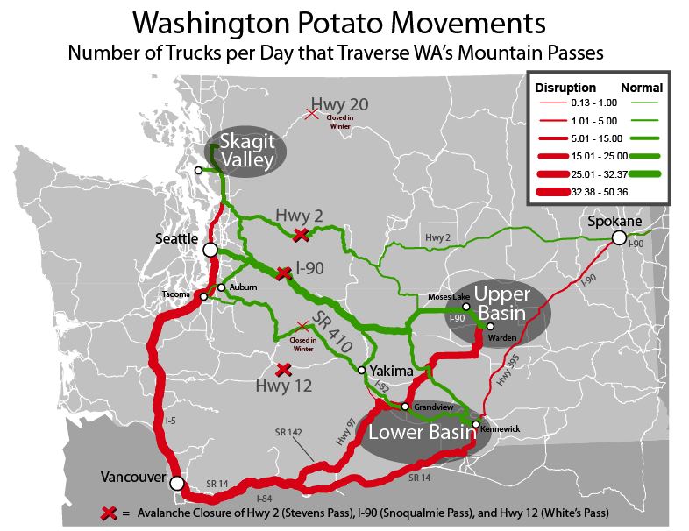
With this info we can model the routes shipments take, and how they would divert in the case of a closure
Many trucks are diverted in the case of a cross-Cascades disruption, resulting in a near doubling of trip lengths

Slide 22
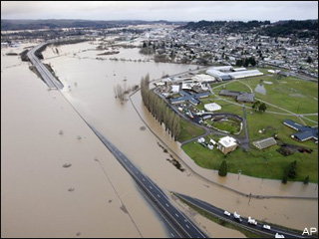
Potato Industry Flows: Summary
Significant cross-Cascades travel
Low profit margins on potato shipments
Cannot afford to take detours
Waiting or failure to stock products are expensive
Very vulnerable to long closures

Slide 23
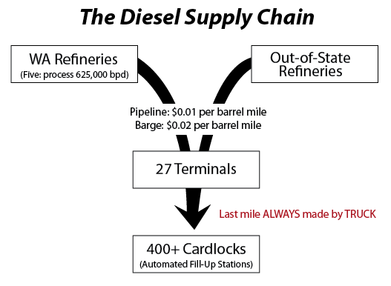

Slide 24
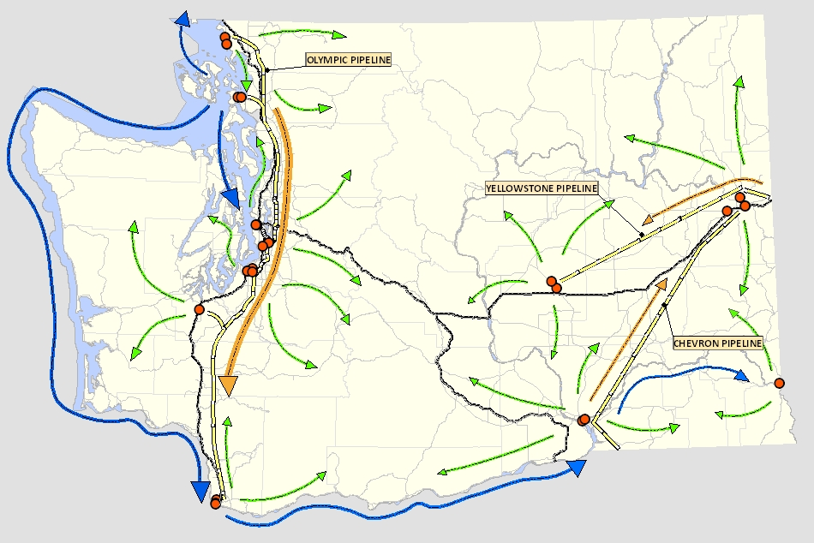
Mapping diesel flows
Long distance movements by barges and in pipelines
because of the large volumes and high cost of movement
Diesel is moved from terminal distribution points by truck to local points of sale.
Modeling the truck movements of diesel as cargo – the green arrows moving away from the red dot terminal locations
terminal racks
truck
pipeline
barge

Slide 25
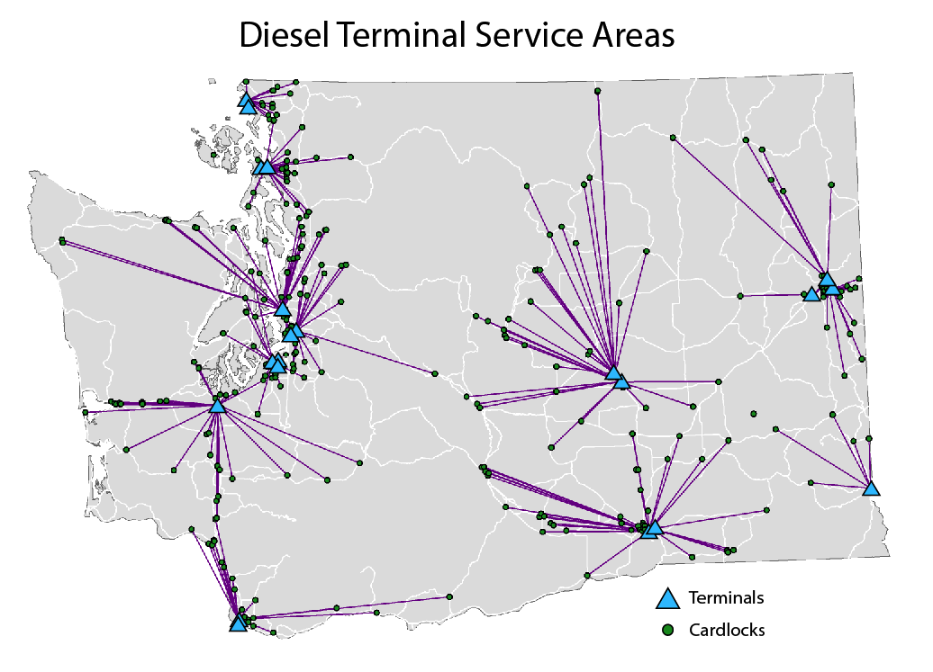
Diesel Terminal Service Areas
Terminals are the origins in the model
locations known
Racks/ cardlocks (points of sale of diesel to consumers) are the destinations
Examining not all, but a majority of these facilities
Locations known
Do not KNOW which terminals serve which racks but we can make assumptions
CASCADES RANGE

Slide 26
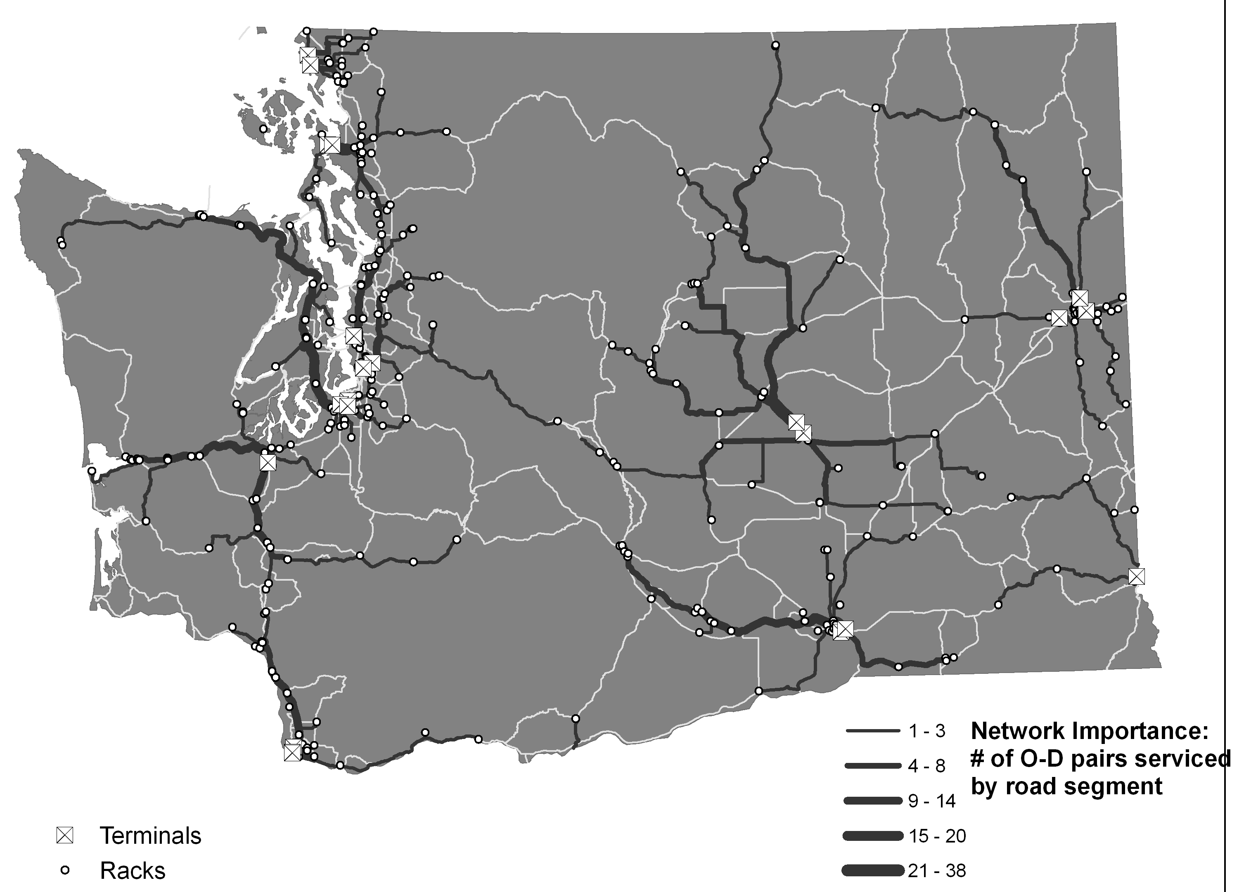
Diesel Network Flow-Map:
Pre-Disruption
Assume racks are served by the closest terminal
can identify shortest path
reasonable since the product quality is relatively consistent & costs are directly tied to traveled distance
Link widths represent the number of OD pairs that would use a link
not weighted by volume, not enough information
useful on a strategic level: some routes heavily used, other pieces of infrastructure do not matter
SEATTLE
SPOKANE
CASCADES RANGE
YAKIMA
VANCOUVER

Slide 27
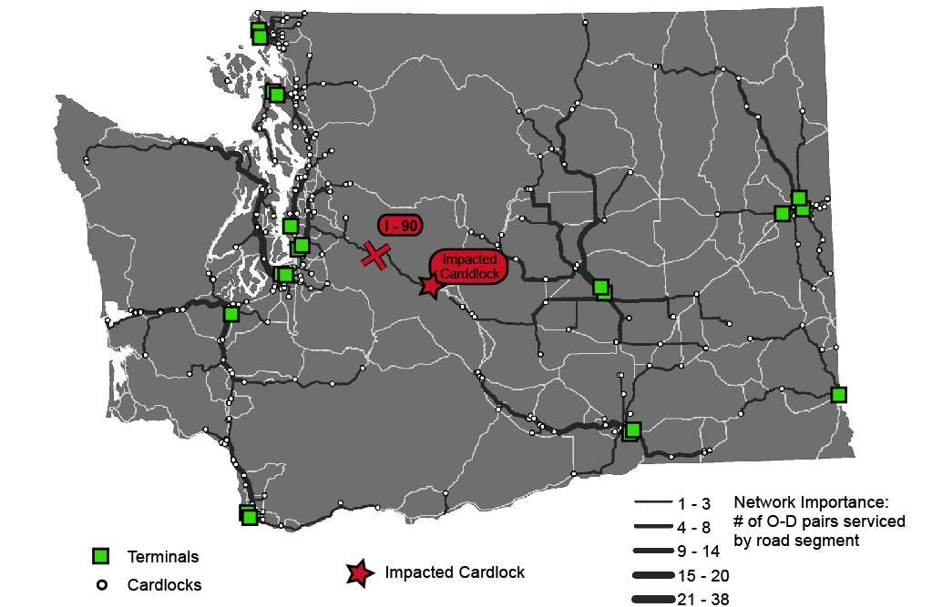
Diesel Network Flow-Map
Adding a cross-Cascades disruption has less impact here (compared to potato distribution)
Only 1 rack in the base case is served by a terminal that would require cross-cascades travel
that rack could easily switch terminals
Increased by 13.3 minutes per trip

Slide 28
Diesel Industry Flows: Summary
Minimal cross-Cascades travel
Multimodal network avoids mountain passes
Distributed terminals provide buffers
Can estimate network segment importance using known information…
BUT cannot assess flows because of lack of information
Diesel is a higher-value industry, but potatoes are more sensitive to road network disruptions
Diesel distribution is HIGHLY vulnerable to pipeline and/or barge disruption
Notes:
Very large volumes are moved

